Slide 1
MPPT in WECS using ML
Submitted by, Siddarth Sreeni Sahitya Tahiliani

Slide 2
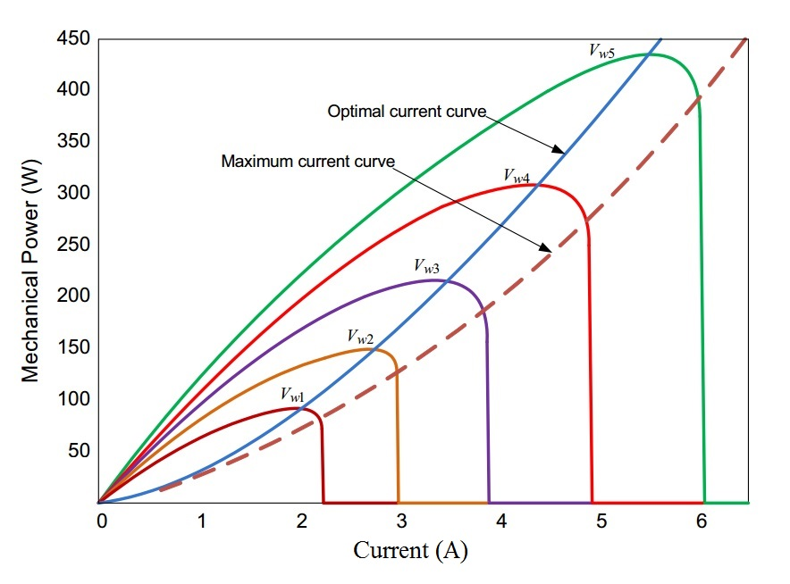
What is MPPT?

Slide 3
Maximum power point tracking (MPPT) is a technique used commonly with wind turbines and photovoltaic solar systems to maximize power extraction under all conditions.
The central problem addressed by MPPT is that the efficiency of power transfer from the wind turbine depends on both the Wind-speed and the electrical characteristics of the load.
As the wind-speed varies, the load characteristic that gives the highest power transfer efficiency changes, so that the efficiency of the system is optimized when the load characteristic changes to keep the power transfer at highest efficiency.
This load characteristic is called the maximum power point and MPPT is the process of finding this point and keeping the load characteristic there.
Electrical circuits can be designed to present arbitrary loads to the wind-turbine and then convert the voltage, current, or frequency to suit other devices or systems, and MPPT solves the problem of choosing the best load to be presented to the cells in order to get the most usable power out.

Slide 4
Algorithms
MPPT Technique | Speed of Convergence | Implementation Complexity | Periodic Tuning | Sensed Parameters
Perturb and Observe | Varies | Low | No | Voltage
Incremental Conductance | Varies | Medium | No | Voltage, Current
Fractional V_{oc} | Medium | Low | Yes | Voltage
Fractional I_{sc} | Medium | Medium | Yes | Current
Fuzzy Logic Control | Fast | Fast | Yes | Varies
Neural Network | Fast | High | Yes | Varies

Slide 5
We use P&O
Modified approach
Supervised AI MPPT controller
Uses Machine Learning
Increase Performance
Accuracy in estimation

Slide 6
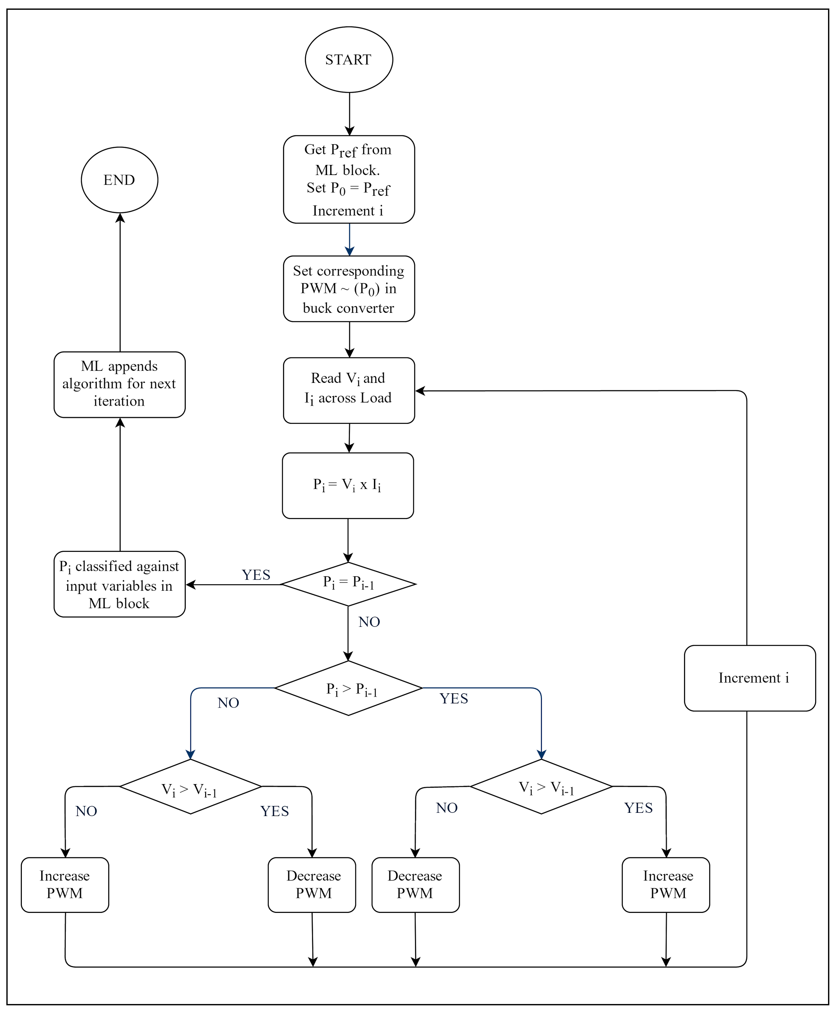
Modified Flow Chart
ML -> P&O

Slide 7
BUCK CONVERTER:
>DC to DC voltage step down converter.
>Connected to the generator output (Input).
>Consists of Diode/Transistor,capacitor,inductor,Load.
>Principle:Inductor Current control
>Uses PWM(Pulse Width Modulation) signal as input
>Works for every iterative clock cycle

Slide 8
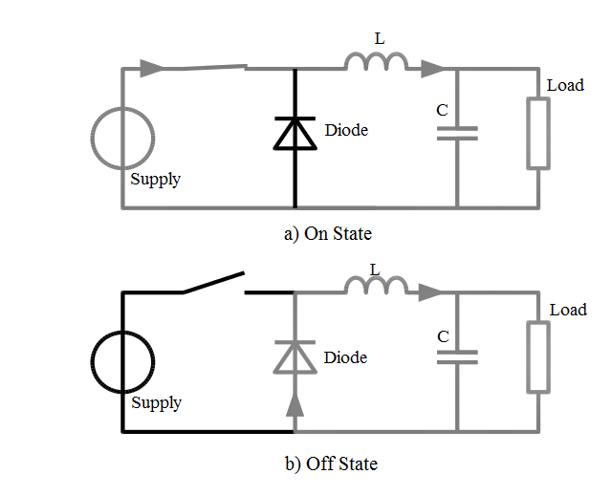
BUCK CONVERTER:
Supply
Connected across the DC generator.
Switch
SMPS
Connected to a microcontroller circuit for PWM signal.
Circuit Diagram of a buck converter

Slide 9
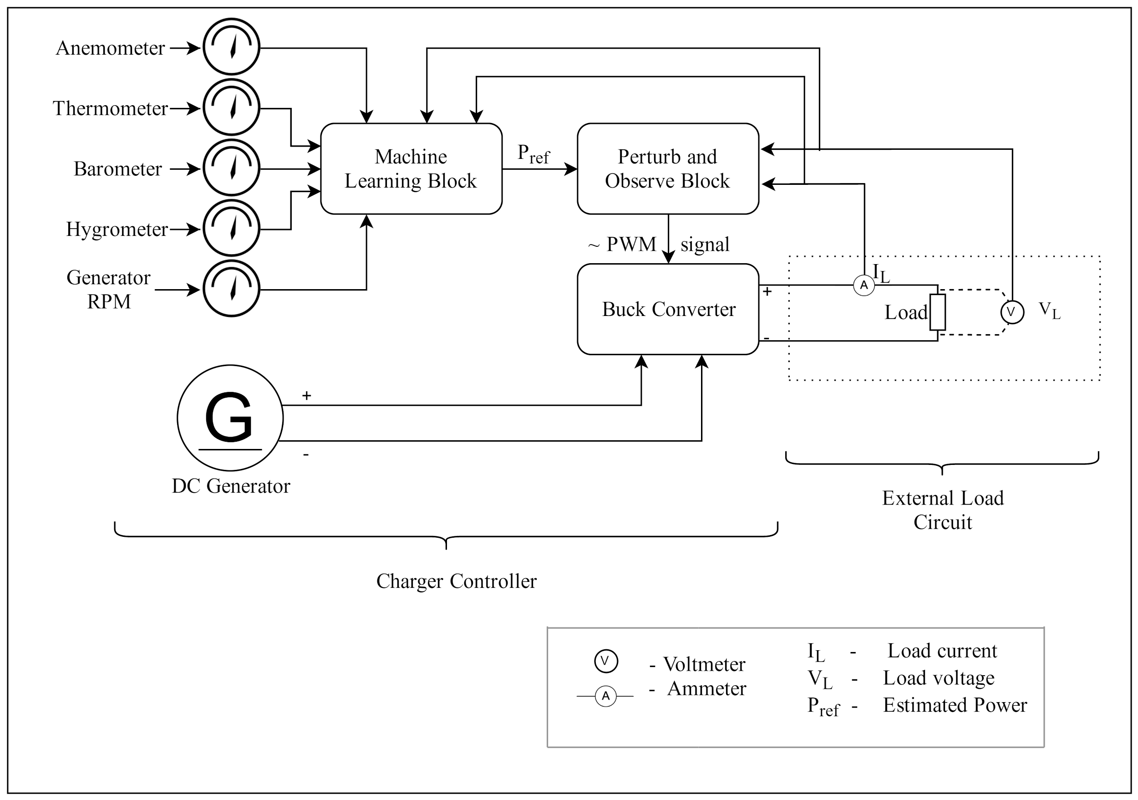
Block Diagram Of The Model

Slide 10
Uses real time information
Pressure
Temperature
Humidity
Generator RPM
Wind Speed
This reduces the offset in reducing the error produced in each estimation by a great factor.

Slide 11
MPPT Algorithm
Error

Slide 12
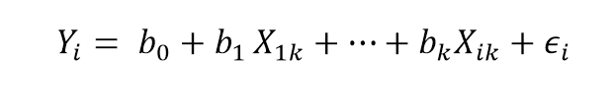
The AI algorithm
Uses a localised linear Regression Model
b_{i} is the characteristic variables
X_{i k} are the input variables corresponding to pressure, temperature, humidity etc.
𝝐_{i} is the error at each iteration i

Slide 13
Overcoming the error
Uses Perturb and Observe.
Only known algorithm to give actual information about the maximum available power (MAP)
Ease of implementation.
Mostly used in current WECS.
Recalculates the MAP from the estimated MPP and writes it back.

Slide 14
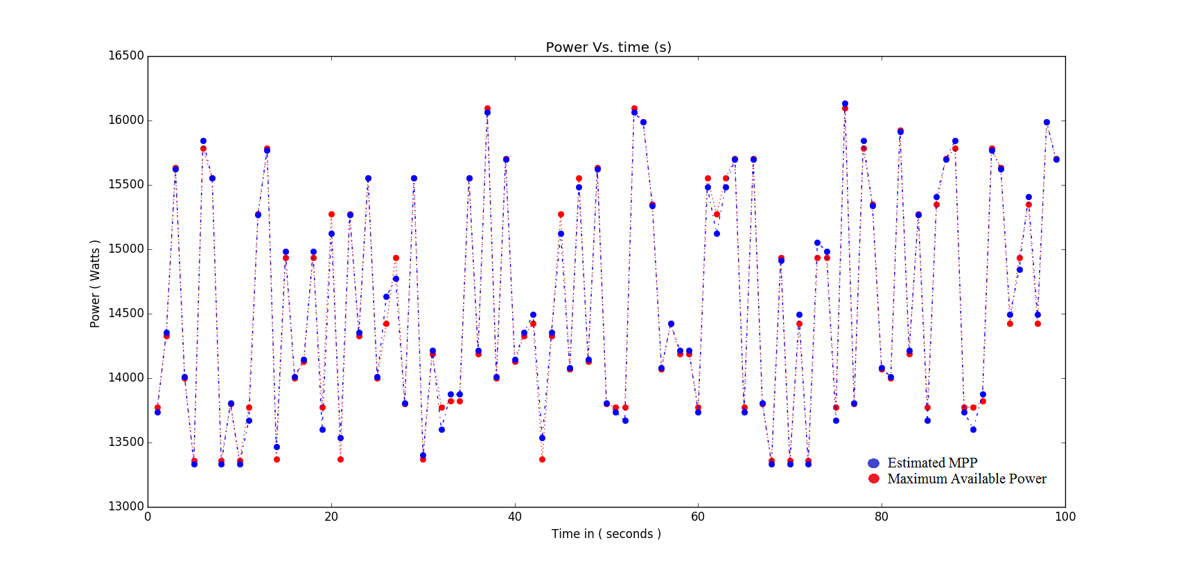
Difference between predicted the MPP and MAP

Slide 15
error ϵ_{i} formed at Iteration i
Overfitting or Underfitting (produced)
Normal HCS from MPP to get MAP

Slide 16
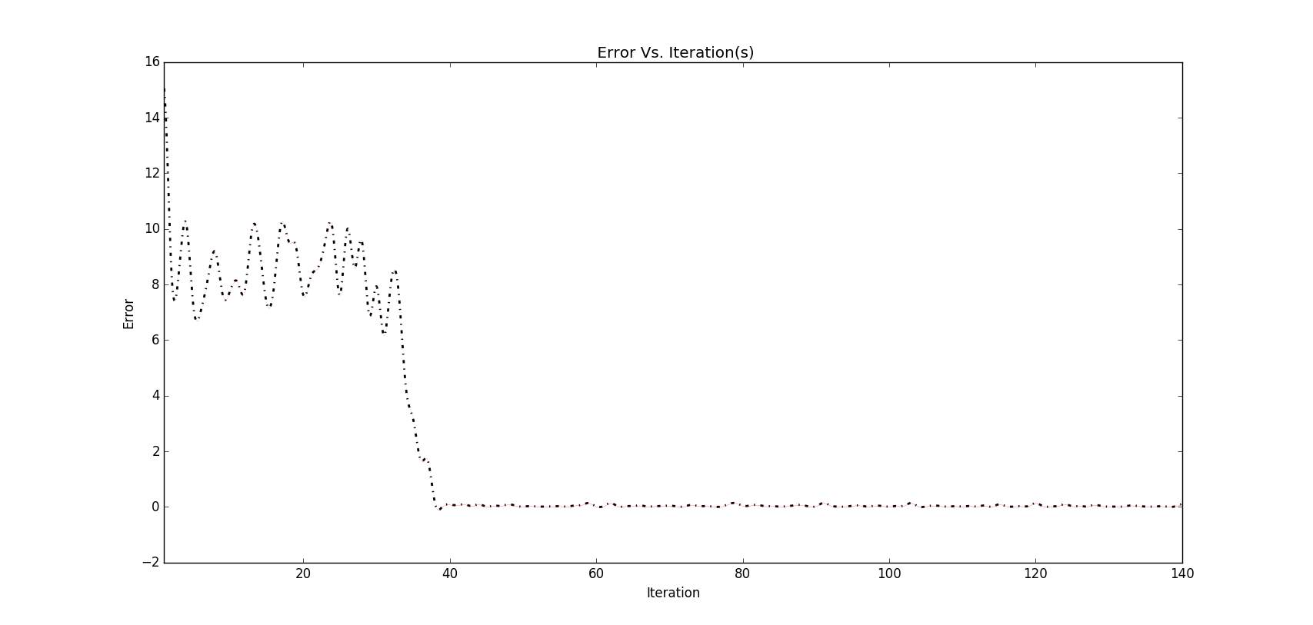
Error formed ϵ_{i}

Slide 17
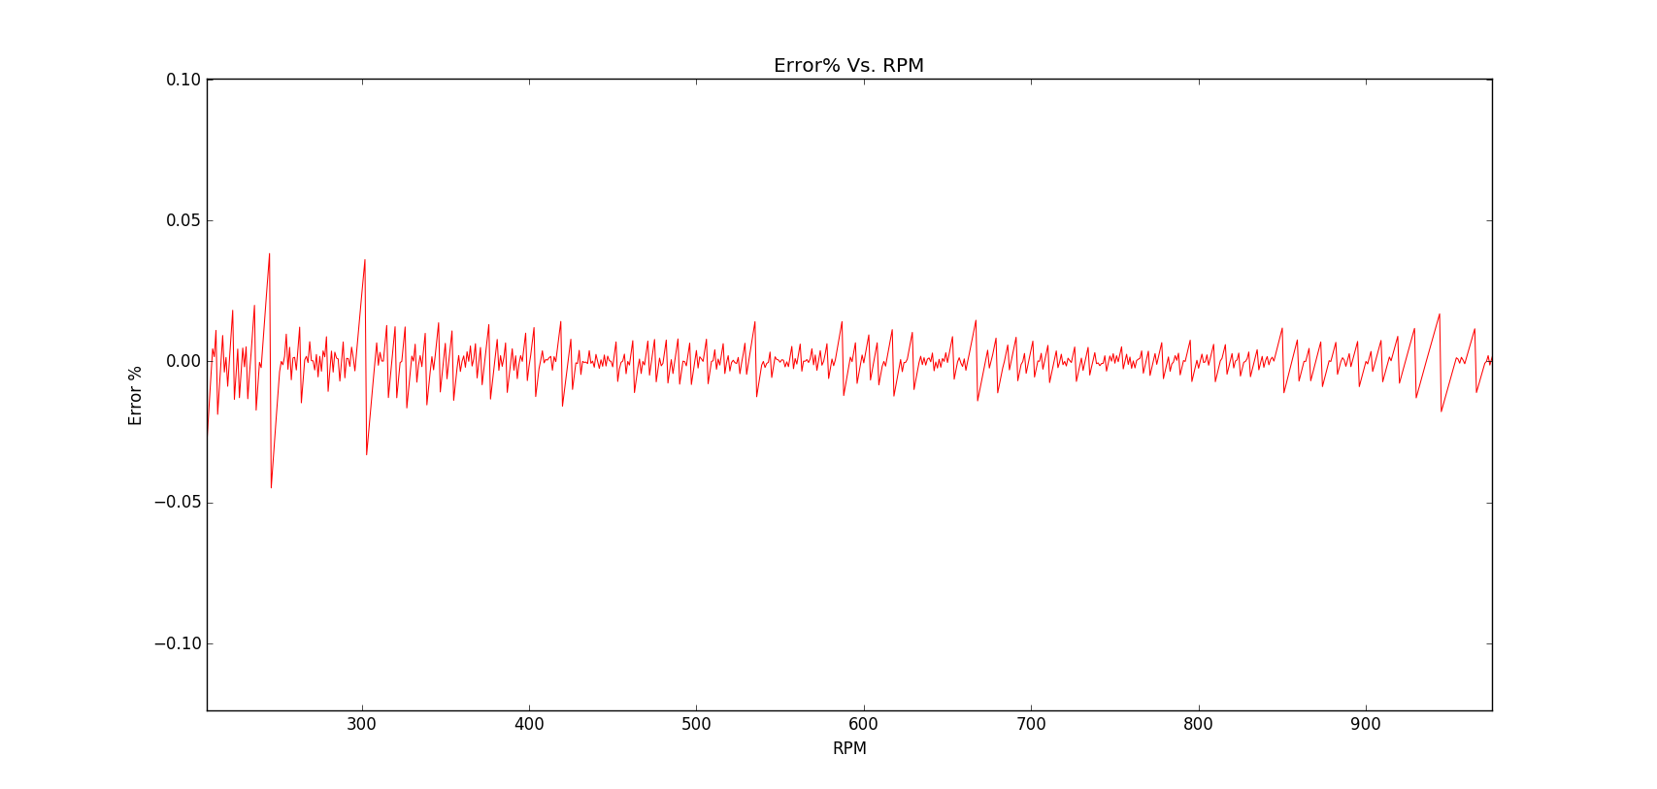
Error expected at each RPM

Slide 18
Conclusion
Results were promising and as expected
Increase in efficiency
Better performance
Faster convergence
Ease of implementation owing to its approach on P&O.
The error decreased drastically from more than 14% to 0.05% in 1000 iterations.
Using AI techniques to estimate MPPT in WECS

